Slide 1
Module 9
Market Segmentation & Targeting Decisions
By: Dr Shahinaz Abdellatif

Slide 2
Objectives of the Session
To understand:
The relationship between segmentation, targeting & positioning (STP)
The growing importance and benefits of segmentation
How to identify market segments
The requirements for effective segmentation

Slide 3
Objectives of the Session
To understand:
The process for targeting market segments based on the fit between market attractiveness and company strengths
Targeting strategies

Slide 4
Segmentation - definition
‘Segmentation is the process by which a market is divided into distinct customer subsets of people with similar needs/characteristics that lead them to respond in similar ways to a particular product offering and strategic marketing programme.’

Slide 5
Targeting - definition
Target marketing requires evaluating the relative attractiveness of various segments (in terms of market potential, growth rate, competitive intensity, and other factors) and
The firm’s mission and capabilities to deliver what each segment wants, in order to choose which segments it will serve.

Slide 6
Positioning - definition
Product positioning entails designing product
offerings and marketing programmes that collectively establish an enduring competitive
advantage in the target market by creating a unique image, or position, in the customer’s mind.

Slide 7
How Are Market Segments Best Defined?
Identify a homogeneous segment that differs from other segments. The process should identify one or more relatively homogeneous groups of prospective buyers with regard to their wants and needs and/or their likely responses to differences in the elements of the marketing mix – the 4 Ps (product, price, promotion, and place).
Specify criteria that define the segment. The segmentation criteria should measure or describe the segments clearly enough so that members can be readily identified and accessed, in order for the marketer to know whether a given prospective customer is or is not in the target market and in order to reach the prospective customer with advertising or other marketing communication messages.
Determine segment size and potential. Finally, the segmentation process should determine the size and market potential of each segment for use in prioritising which segments to pursue.

Slide 8
Identification of Market Segments
3 major categories of descriptors for consumer/industrial markets:
1. Demographic Descriptors
2. Geographic Descriptors
3. Behavioural Descriptors

Slide 9
Identification of Market Segments
Demographic Descriptors (which reflect who the target customers are).
Consumer Markets versus Business markets
Age Age of Firm
Sex Size of firm
Income Revenues, profits
Occupation Type of sector (SIC code)
Education

Slide 10
Identification of Market Segments
Geographic Descriptors (where they are)
geographic location
distance/ drive time

Slide 11
Identification of Market Segments
3. Behavioural Descriptors (how they behave with regard to their use and/or purchases of a given category of goods or services).
Usage
Life–style (activities, interest, & opinion)
Loyalty
Purchase influence
Life value of customers
Product benefits (evaluation criteria)
Buying situation

Slide 12
Analysing & Prioritising Potential Markets
Common analytical framework
e.g. Market attractiveness/business position matrix
Allocate resources across business/product lines
Forecasting

Slide 13
Analysing & Prioritising Potential Markets
Market-attractiveness/ competitive-position matrix is used for analysing current and potential target markets.
Underlying such a matrix is the notion that managers can judge the attractiveness of a market (its profit potential) by examining market, competitive, and environmental factors that may influence profitability.
Similarly, they can estimate the strength of the firm’s competitive position by looking at the firm’s capabilities or shortcomings relative to the needs of the market and the competencies of likely competitors (SWOT analysis).

Slide 14
Steps in Constructing a Market-Attractiveness/
Competitive-Position Matrix
1. Choose criteria to measure market attractiveness and competitive position.
2. Weight market attractiveness and competitive position factors to reflect their relative importance.
3. Assess the current position of each potential target market on each factor.
4. Project the future position of each market based on expected environmental, customer, and competitive trends
5. Evaluate implications of possible future changes for business strategies and resources requirements.
Notes:
7

Slide 15
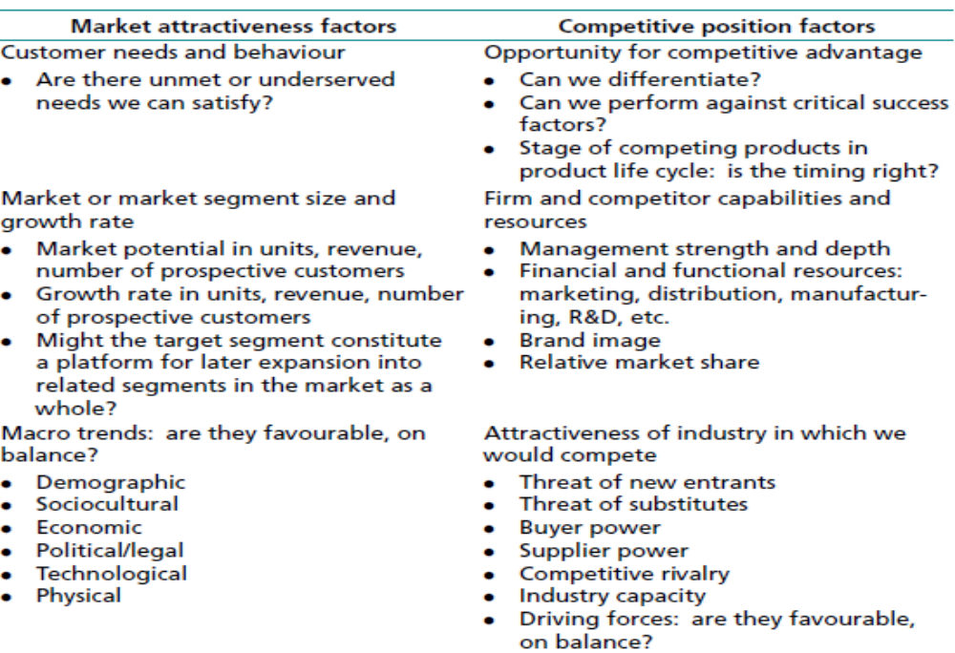
Step (1) Choose criteria to measure market attractiveness and competitive position

Slide 16
Step (2) Weight market attractiveness & competitive position factors to reflect their relative importance.
Next, a numerical weight is assigned to each factor to indicate its relative importance in the overall assessment.

Slide 17
Step (3) Rate Segments on Each Factor, Plot Results on Matrices
This step requires that evidence – typically both qualitative and quantitative data – be collected to objectively assess each of the criteria identified in Step 1.

Slide 18
Step (3) Rate Segments on Each Factor, Plot Results on Matrices
Weight Rating(0–10 scale) Total
Market attractiveness factors
Customer needs and behavior: unmet needs?
Segment size and growth rate
Macro trends
Total: market attractiveness
Competitive position factors
Opportunity for competitive advantage
Capabilities and resources
Industry attractiveness
Total: competitive position

Slide 19
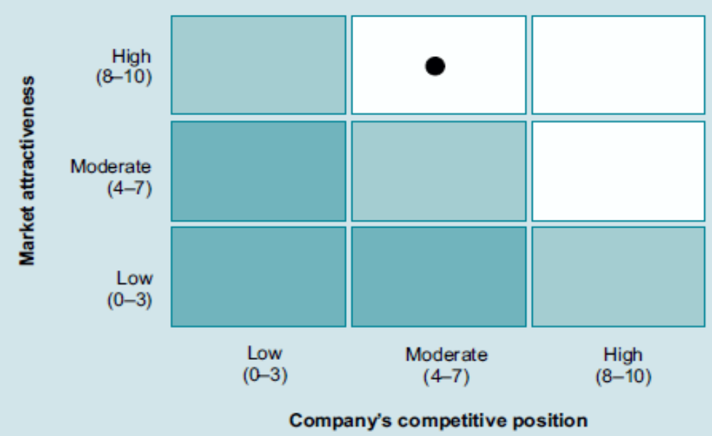
Matrix showing the attractiveness of target segment based on a matching of market attractiveness and competitive position

Slide 20
Step (4) Project Future Position for Each Segment
Forecasting a market’s future is more difficult than assessing its current state. Marketers should first determine how the market’s attractiveness is likely to change over the next three to five years.
The starting point for this assessment is to consider possible shifts in customer needs and behaviour, the entry or exit of competitors, and changes in their strategies, possible changes in product or process technology, shifts in the economic climate, the impact of social or political trends, and shifts in the bargaining power of customers.
Managers must next determine how the business’s competitive position in the market is likely to change, assuming that it responds effectively to projected environmental changes but the firm does not undertake any initiatives requiring a change in basic strategy.
The expected changes in both market attractiveness and competitive position can then be plotted on the matrix in the form of a vector (arrow) that reflects the direction and magnitude of the expected changes.

Slide 21
Step 5: Choose Segments to Target, Allocate Resources
Matrix includes markets positioned in any of the three cells in the upper right-hand corner of the matrix.
However, a business may decide to enter a market that currently falls into one of the middle cells under these conditions:
(1) managers believe that the market’s attractiveness or their competitive strength is likely to improve over the next few years;
(2) they see such markets as stepping-stones to entering larger, more attractive markets in the future; or
(3) shared costs are present, thereby benefiting another entry.

Slide 22
Market attractiveness /competitive-position matrix for target market selection, strategic objectives & resource allocation
COMPETITIVE POSITION
Strong
Medium
Weak
PROTECT
- Invest to grow
- Maintain Strength
INVEST TO BUILD
- Challenge
leadership
- Build selectively
- Reinforce vulnerable
areas
BUILD SELECTIVELY
- Specialise around
limited strengths
- Seek to overcome
weaknesses
- Withdraw
High
MARKET
ATTRACTIVENESS
DESIRABLE POTENTIAL TARGET
- Build selectively
- Increase profits
MANAGE FOR EARNINGS
Protect strengths
Invest in low risk
areas
LIMITED EXPANSION HARVEST
-Expand without risk
Minimise investment
Medium
PROTECT & REFOCUS
Defend
Increase earnings
without speeding
decline
MANAGE FOR EARNINGS
Protect positions
Minimise investment
DIVEST
Sell
Cut fixed costs
Avoid investment
Low
Criteria (internal/external)
Weightings
Resource allocation
General guidance

Slide 23
Targeting Strategies
1- Mass Market Strategies
Option 1: Ignore segment differences – single product and-marketing programme that will appeal to the largest number of consumers.
Captures sufficient volume to gain economies of scale and a cost advantage.
Requires substantial resources, including production capacity, and good mass-marketing capabilities.
Favours large business

Slide 24
Targeting Strategies
1- Mass Market Strategies
Option 2: Differentiated marketing
Design separate products and marketing programmes for different market segments.
Increased costs (production/marketing)
Eg; Marriott – Luxury (JW) & budget chains
Toyota - (Toyota versus Lexus)

Slide 25
Targeting Strategies
2- Growth Markets
Fast growth sectors (potential)
Favoured by smaller companies to avoid large competitors
R&D
Marketing research
Attracts large companies quickly
e.g. Easyjet/Go

Slide 26
Targeting Strategies
3- Niche Markets
This strategy involves serving one or more segments that is not the largest.
Customer segments seek specialised benefits
Avoids direct competition with larger firms
Eg: Specialist magazines/clubs, etc...

Slide 27
Global Market Segmentation and Targeting Strategies
Traditional Approach
This strategy involves view a country or a group of countries as a single segment comprising all consumers.
This approach is seriously flawed because it relies on country variables rather than consumer behaviour, assumes homogeneity within the country segment, and ignores the possibility of the existence of homogeneous groups of consumers across country segments.

Slide 28
Global Market Segmentation and Targeting Strategies
New Approach
More and more companies are approaching global market segmentation by attempting to identify consumers with similar needs and wants reflected in their behaviour in the marketplace in a range of countries.
This inter-country segmentation enables a company to develop reasonably standardised programs requiring little change across local markets, thereby resulting in scale economies.

